Slide 1
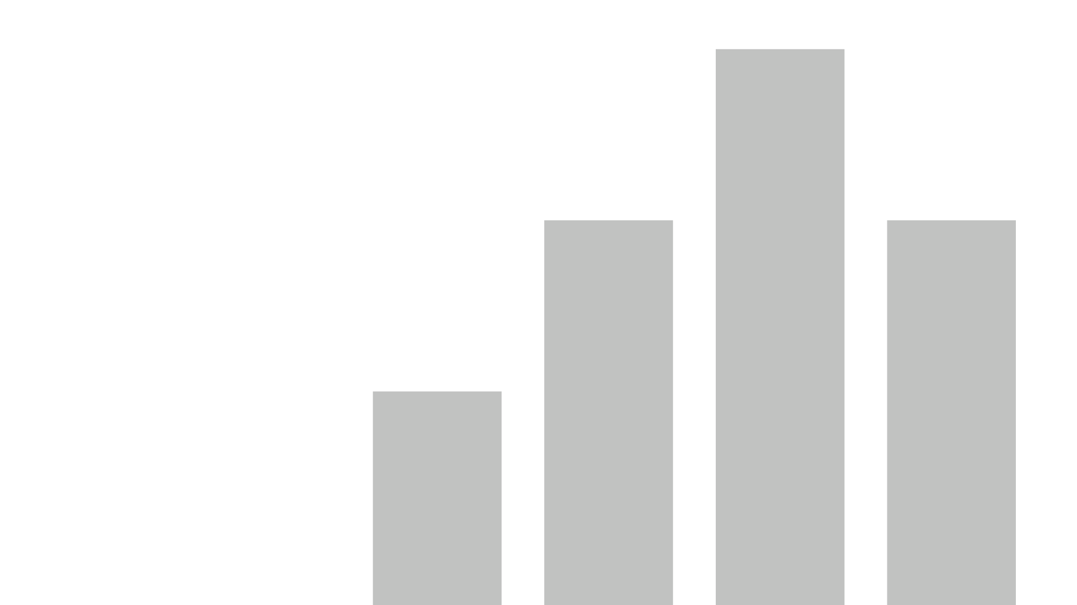


Dashboard Leon, Gabriela
View in Power BI
Last data refresh:
1/7/2023 8:00:14 PM UTC
Downloaded at:
1/7/2023 8:32:27 PM UTC

Slide 2
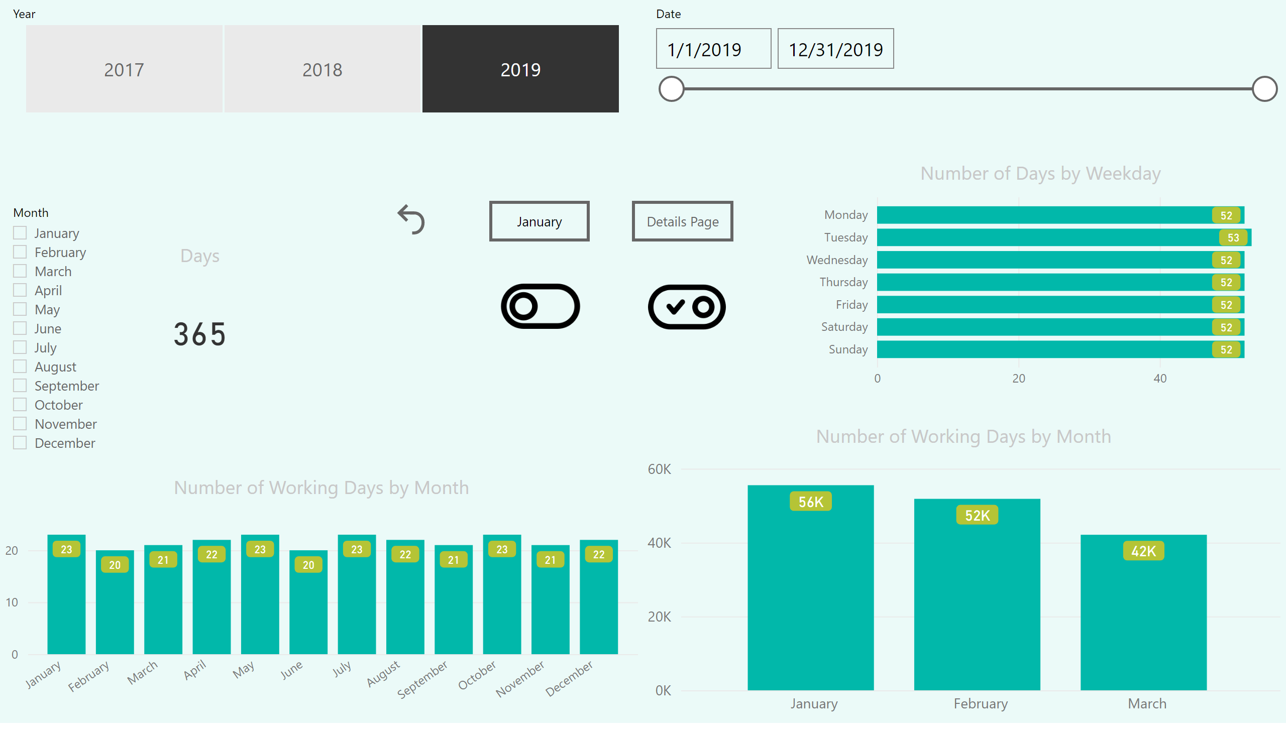
Page 1
Notes:
image
No alt text provided
image
No alt text provided
actionButton
No alt text provided
actionButton
No alt text provided
actionButton
No alt text provided
Number of Working Days by Month
No alt text provided
Days
No alt text provided
Number of Days by Weekday
No alt text provided
slicer
No alt text provided
slicer
No alt text provided
slicer
No alt text provided
Number of Working Days by Month
No alt text provided

Slide 3
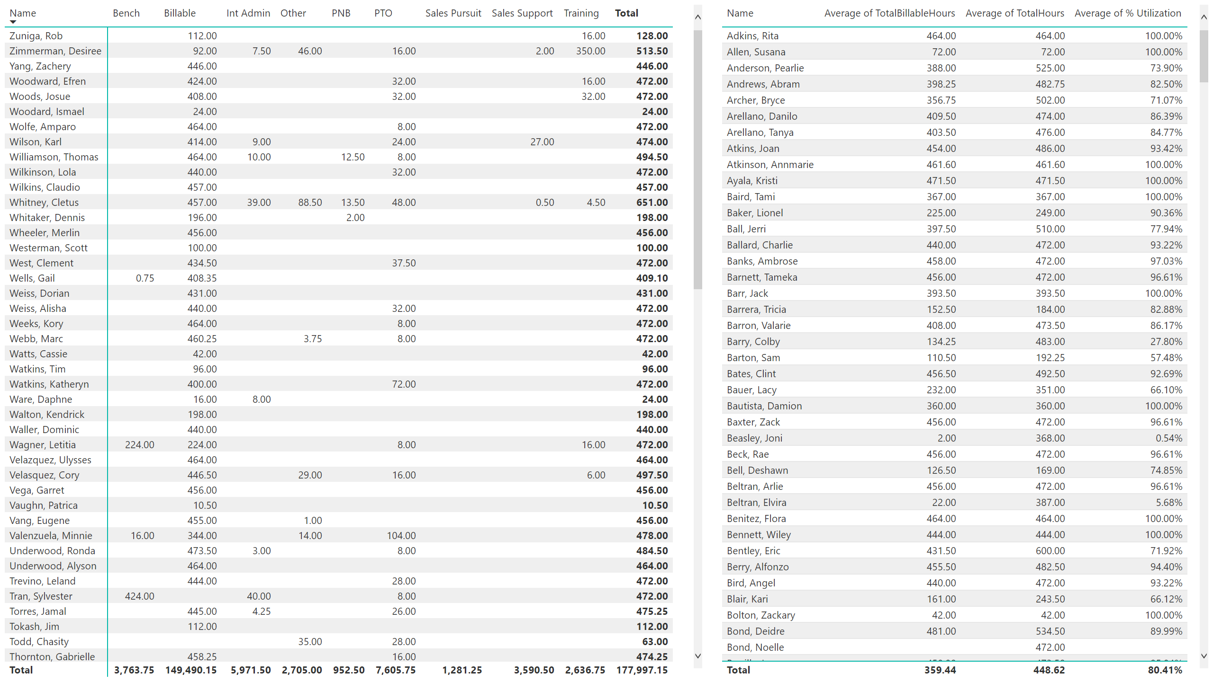
Page 2
Notes:
pivotTable
No alt text provided
tableEx
No alt text provided

Slide 4
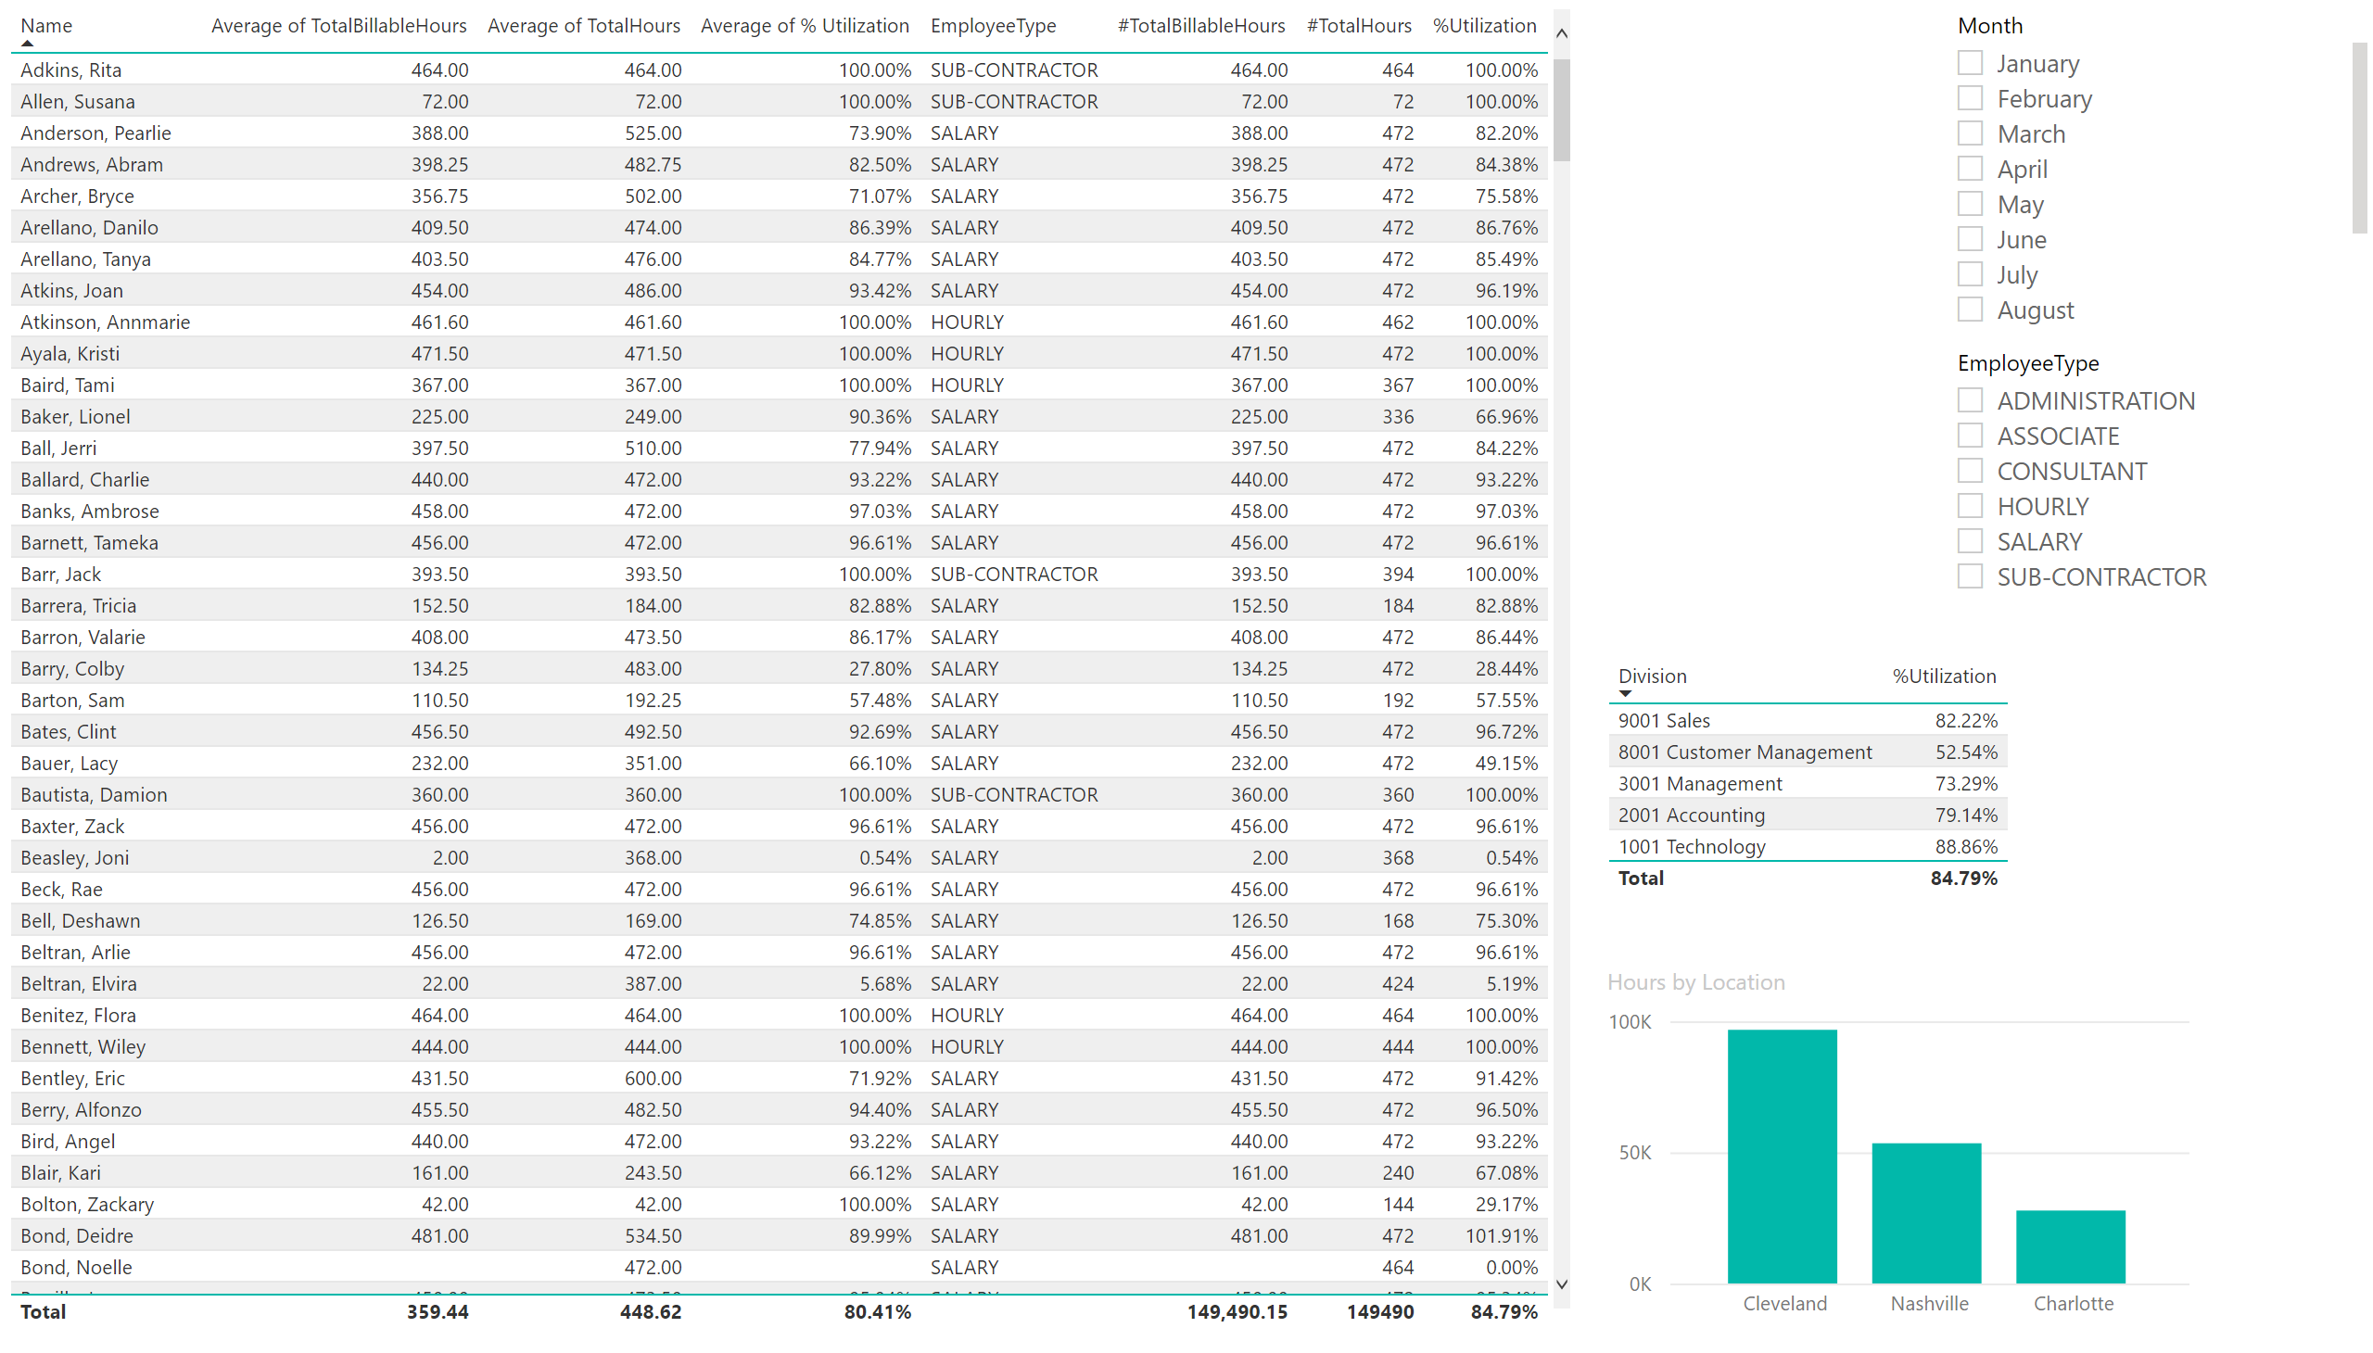
Duplicate of Page 2
Notes:
tableEx
No alt text provided
slicer
No alt text provided
slicer
No alt text provided
tableEx
No alt text provided
clusteredColumnChart
No alt text provided

Slide 5
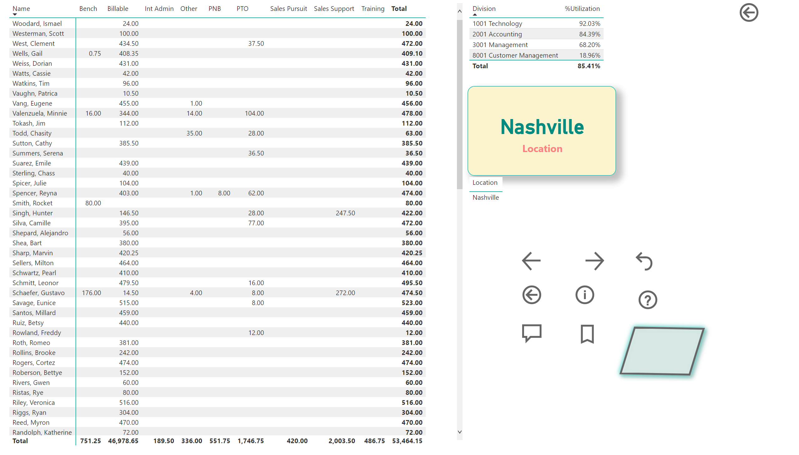
Details
Notes:
pivotTable
No alt text provided
tableEx
No alt text provided
card
No alt text provided
tableEx
No alt text provided
actionButton
No alt text provided
actionButton
No alt text provided
actionButton
No alt text provided
actionButton
No alt text provided
actionButton
No alt text provided
actionButton
No alt text provided
actionButton
No alt text provided
actionButton
No alt text provided
actionButton
No alt text provided
actionButton
No alt text provided

